Slide 1
Introduction to Information Security and the CIA Triad
Lecture 1

Slide 2
What is security?
“Achieving something in the presence of an adversary.”
The internet is full of adversaries. This signifies the design of a system that can provide protection against all these adversaries.
A solid security plan consists of the following concepts:
Policy: the goal you want to achieve
Threat model: assumptions about the capabilities of the adversaries
Mechanism: how the policy could be implemented
Resulting goal: no way for adversary within threat model to violate policy

Slide 3
What is security?
Why is Security Hard?
It is easy to design policy. The system should only be accessed by the authorized persons. Positive goals can be easily achieved and evaluated.
A threat model is difficult to formulate. Realistic threat models are open-ended (almost negative models). It is not possible to think about all the possible actions the adversary can take.
Due to insufficient assumptions of the threat model, near-perfect implementation of security can result in vulnerabilities and exploitations. Therefore, security is an iterative process: design, update threat model as necessary, etc.
This is why it is essential to study security from both perspectives: the attacker (Red side) and the defender (Blue side).

Slide 4
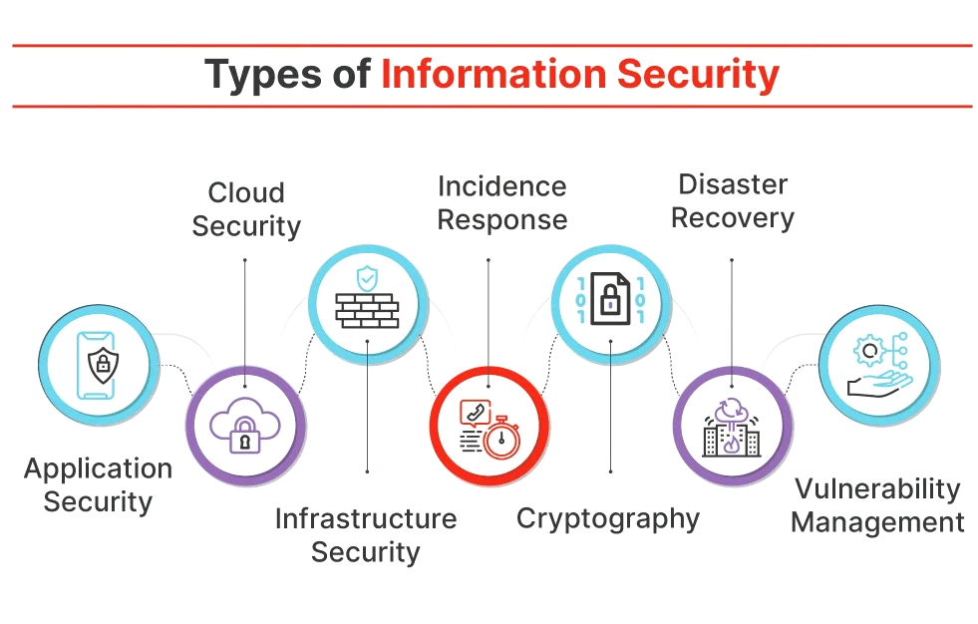
What is Information Security?
“The practice and discipline of protecting information and information systems from unauthorized access, use, disclosure, disruption, modification, or destruction.”

Slide 5
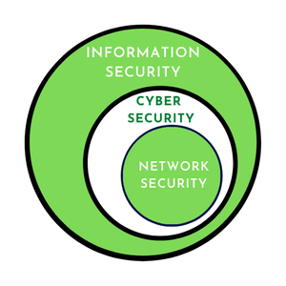
Information Security vs Cybersecurity
Information security is the practice of protecting information from unauthorized access or harm.
Cybersecurity is the protection of computer systems, networks, and data from digital threats and attacks.
An example of information security is a company locking sensitive documents in a physical filing cabinet to prevent theft, while an example of cybersecurity is a firm using firewalls and encryption to stop hackers from accessing customer data on their servers

Slide 6
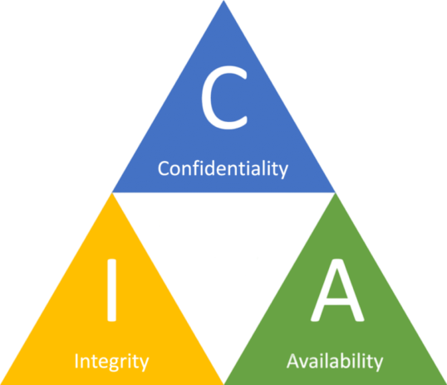
Core Principles of Information Security—The CIA Triad
The CIA triad, also known as the information security triad, is a widely recognized model that represents the core principles of information security. It stands for Confidentiality, Integrity, and Availability, and these three principles form the foundation of a secure and well-rounded information security framework.
Confidentiality- No unauthorized access
Integrity - No unauthorized modifications
Availability- Information available to authorized users only

Slide 7
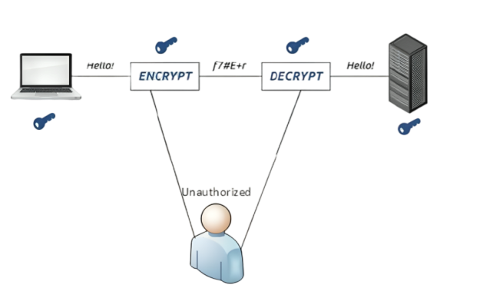
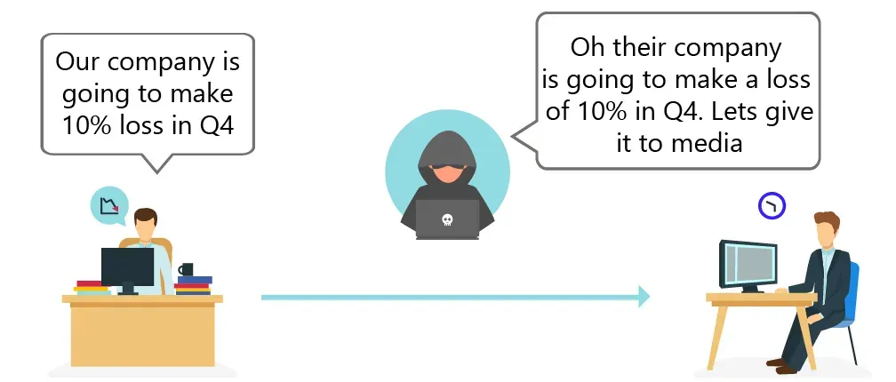
The CIA Triad
Confidentiality: Ensuring that information is accessible only to authorized individuals and protected from unauthorized access or disclosure.
For example, when you log into your email account, you expect that only you can read your emails, not anyone else.
Confidentiality
Loss of Confidentiality

Slide 8
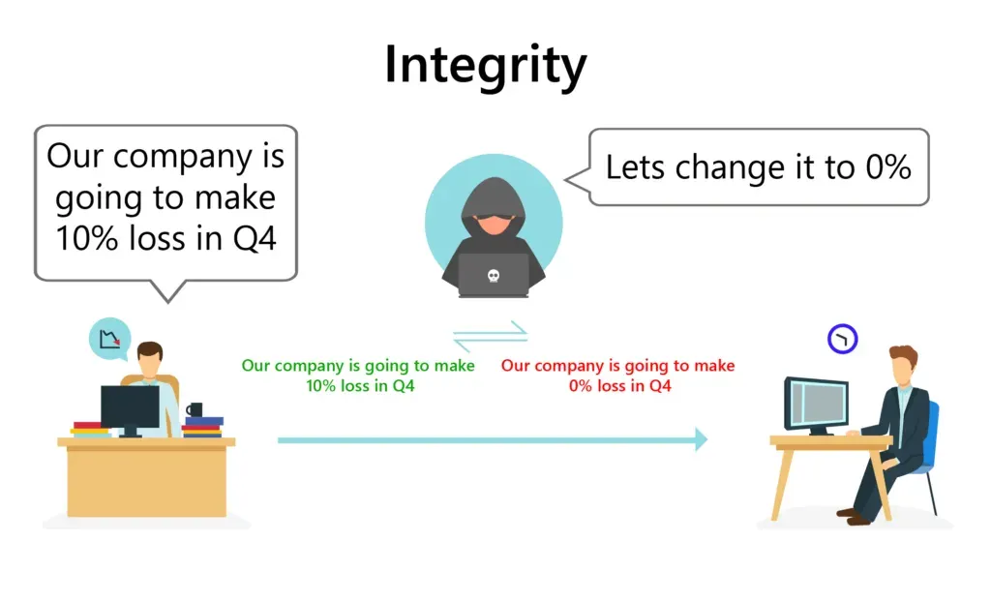
The CIA Triad
Integrity: Maintaining the accuracy, completeness, and trustworthiness of information by preventing unauthorized modification or tampering.
Example: Imagine you submit an online application form for a job. Integrity ensures that the information you entered (e.g., your personal details, qualifications, and work experience) remains unchanged and accurate when it reaches the employer's database. If someone maliciously alters your application data during transmission, integrity mechanisms would detect and prevent such unauthorized changes.
Loss of Integrity

Slide 9

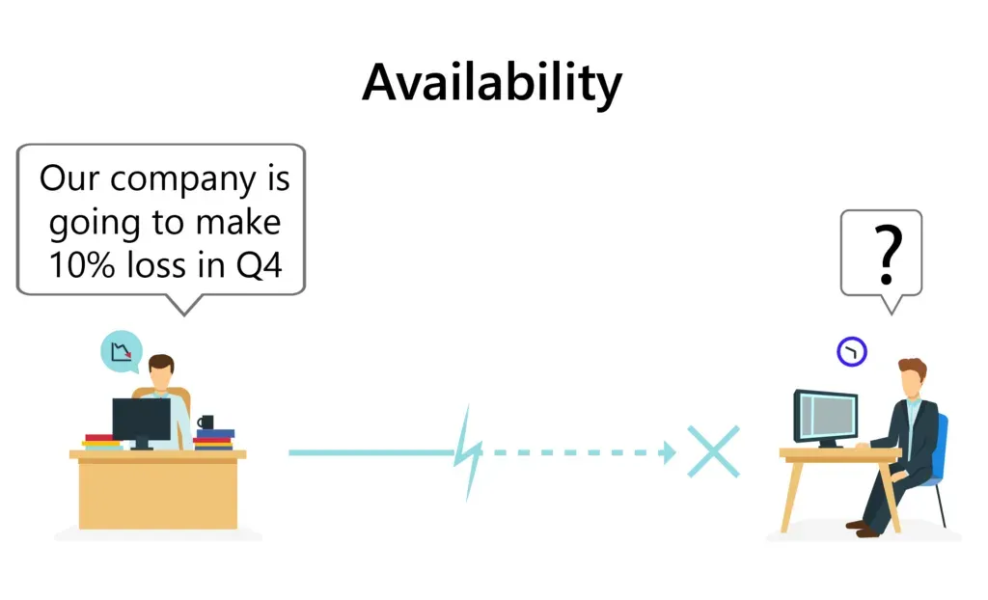
The CIA Triad
Availability: Ensuring that information and systems are accessible and usable when needed by authorized users and protected from disruptions or outages.
Consider an e-commerce website during a sale event. Availability ensures that the website remains operational and responsive despite a surge in visitor traffic. If the website crashes or becomes unavailable due to high demand, customers may not be able to complete their purchases, impacting the business's revenue and customer satisfaction.
Loss of Availability

Slide 10
Examples of CIA Triad
To have a better understanding of how the CIA triad works in practice, consider an ATM that allows users to access bank balances and other information. An ATM incorporates measures to cover the principles of the triad:
The two-factor authentication (debit card with the PIN code) provides confidentiality before authorizing access to sensitive data.
The ATM and bank software ensure data integrity by maintaining all transfer and withdrawal records made via the ATM in the user’s bank accounting
The ATM provides availability as it is for public use and is accessible at all times.

Slide 11
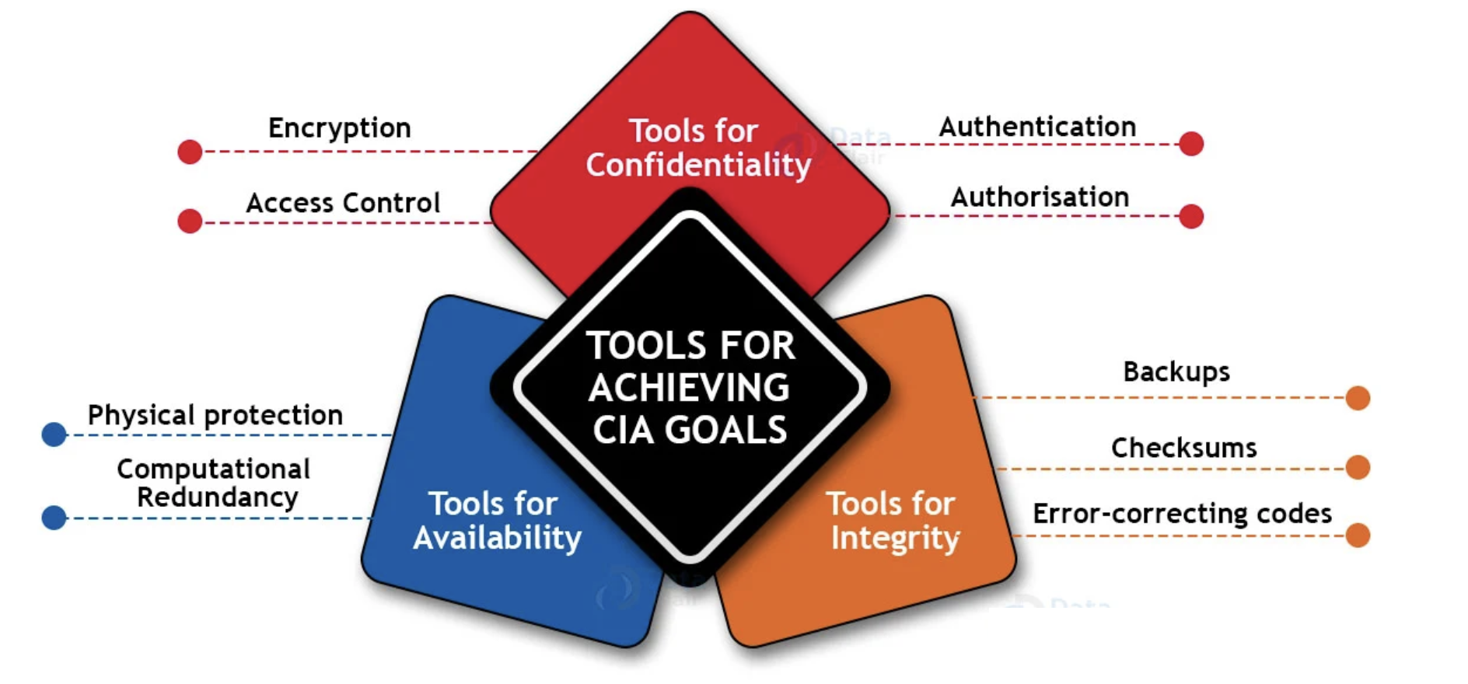
Tools for Achieving CIA Goals

Slide 12
Tools for Achieving Confidentiality

Slide 13
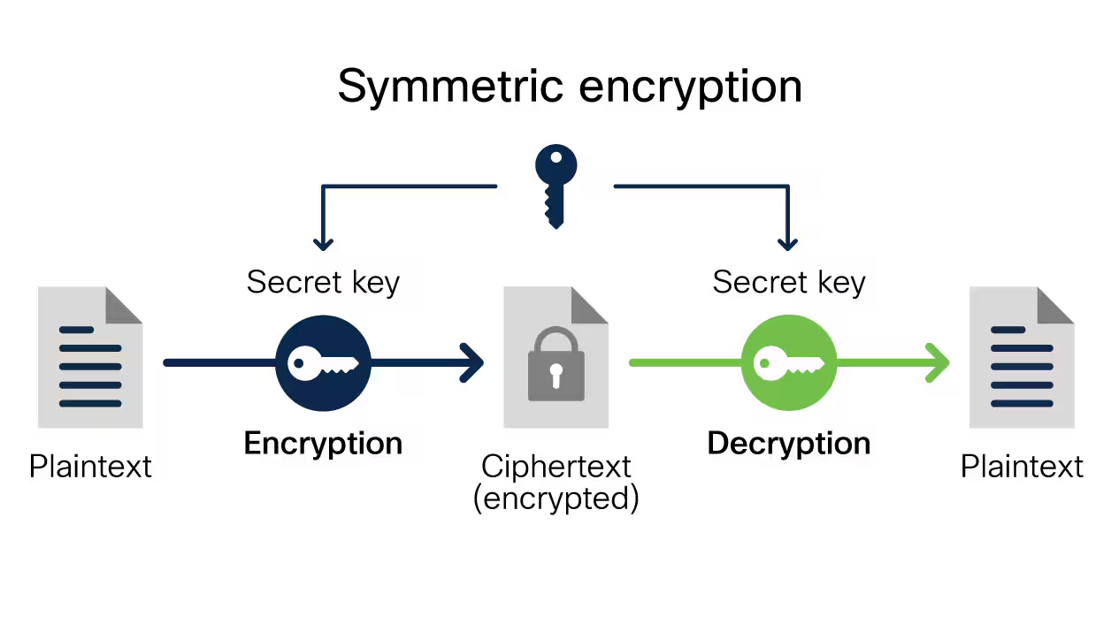
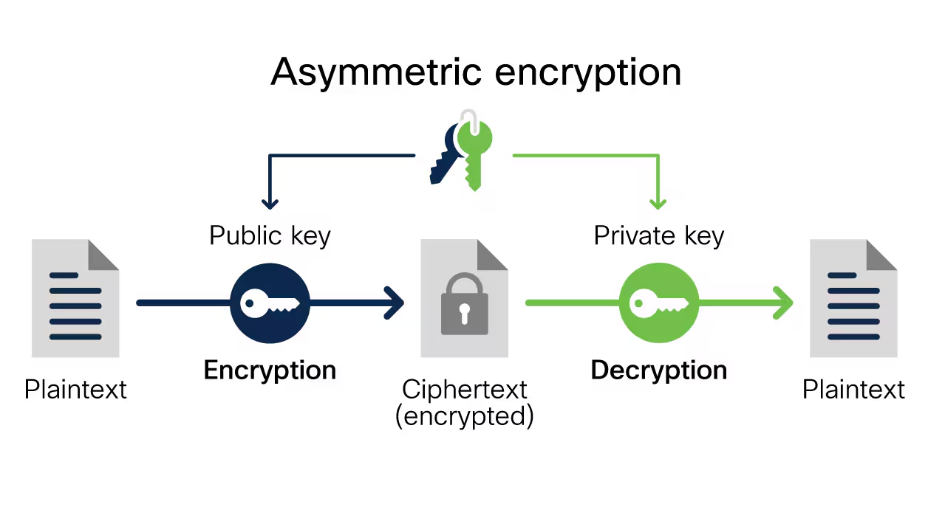
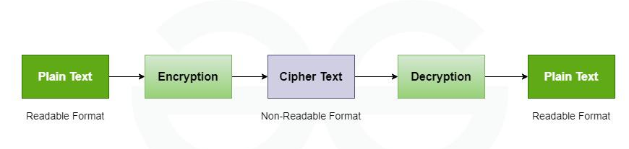
Encryption
Encryption, as the name suggests, is generally a technique that is used to conceal messages using algorithms. It is the fundamental application of cryptography that encodes a message with an algorithm. It generally helps to protect private information and sensitive data and enhance the security of communication among client apps and servers. It is considered one of the most effective and popular data security techniques.
Data encryption is a good example to ensure confidentiality.
Encryption Types
Symmetric encryption uses the same key for encryption and decryption.
Asymmetric encryption uses two separate keys: a public key and a private key.

Slide 14
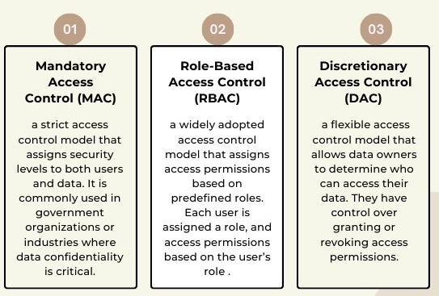
Access Control
Different Types ACP
Confidentiality is maintained through access control by strictly limiting access to sensitive information, ensuring only authorized individuals can view, modify, or delete it.
Access control policies (ACP) define the rules and regulations that govern who can access what information and under what circumstances.
By implementing access control policies, organizations can ensure that only authorized individuals have access to sensitive information, minimizing the risk of data breaches and unauthorized disclosures.

Slide 15
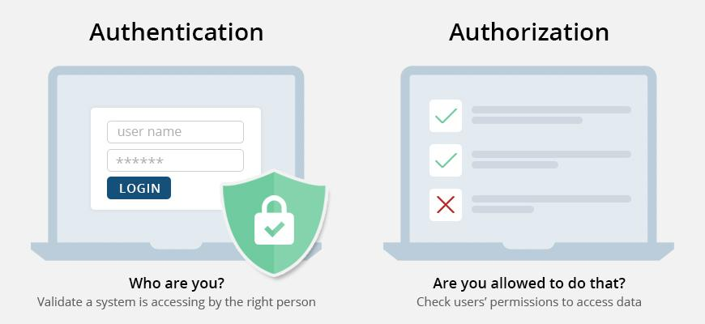
Authentication and Authorization
Confidentiality is maintained through authentication (verifying a user's identity) and authorization (granting access to specific data or functions), ensuring only the correct individuals can view sensitive information.
Authentication: Verifying the identity of users or systems to ensure they are who they claim to be.
Authorization: Granting or denying access to resources based on a user’s permissions or privileges limits what actions they can perform.

Slide 16
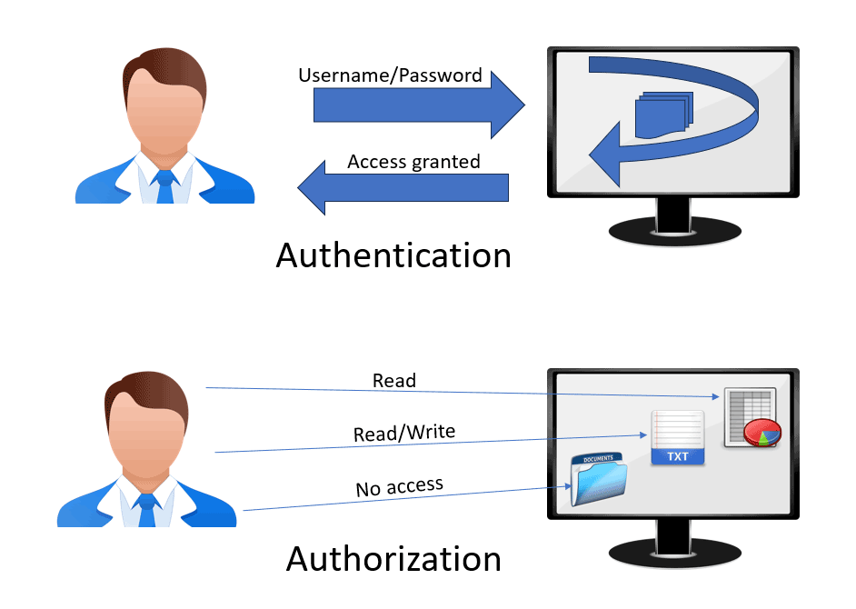
Authentication and Authorization
When you log into a railway booking website with your username and password, the site first checks if your credentials are correct (Authentication). After you’re logged in, the system gives you access only to the actions allowed for your account, such as booking tickets, viewing your own travel history, or canceling your reservations, but not accessing the admin panel or changing other passengers’ bookings (Authorization)

Slide 17
Tools for Achieving Integrity

Slide 18
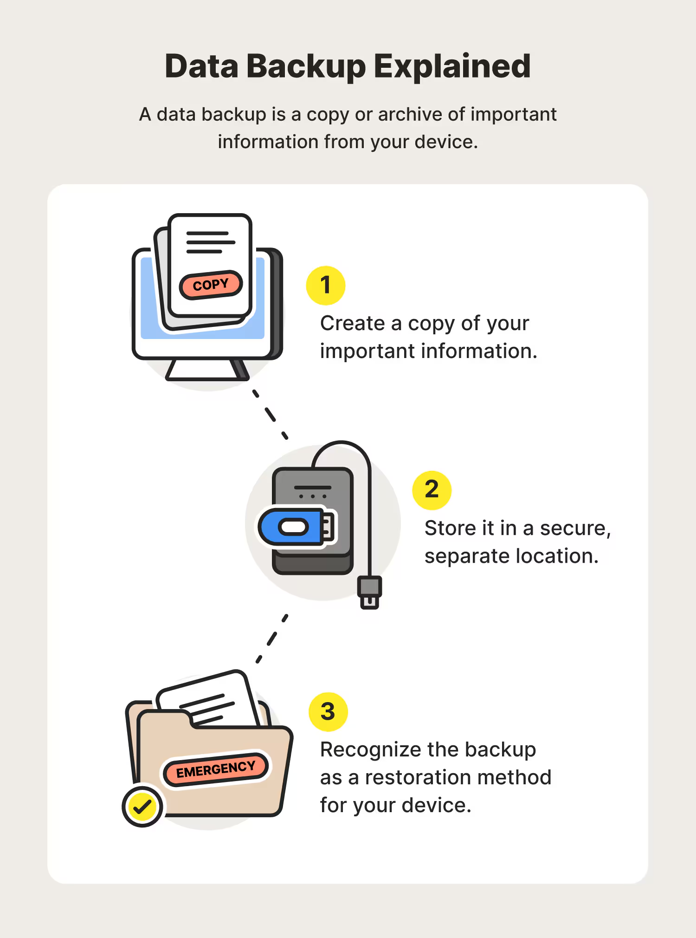
Data Backups
Data backups ensure integrity by keeping an original, accurate copy of information that can be restored if the active system’s data is corrupted, accidentally deleted, or maliciously altered.
For example, if a hacker changes marks in a university’s student result database, the backup provides the correct version, proving that the original data has not been tampered with.

Slide 19
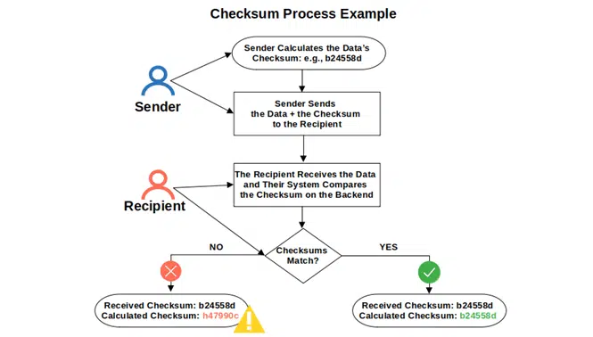
Checksum
A checksum is a value derived from a block of data using simple arithmetic operations such as addition or cyclic redundancy checks (CRC).
Its main goal is to detect accidental errors (like noise in communication channels or corruption in storage).
For example, in networking, TCP/IP uses checksums to ensure that packets are received without random corruption.
However, checksums are not cryptographically secure, because if an attacker deliberately alters the data, they can easily recalculate a new checksum to match the modified data. This means a checksum can tell you if data was damaged by accident, but not if it was tampered with intentionally.

Slide 20
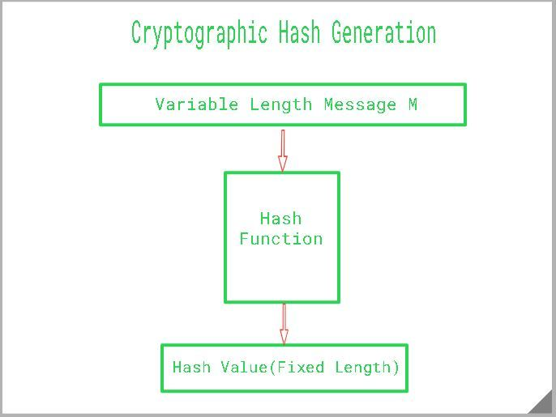
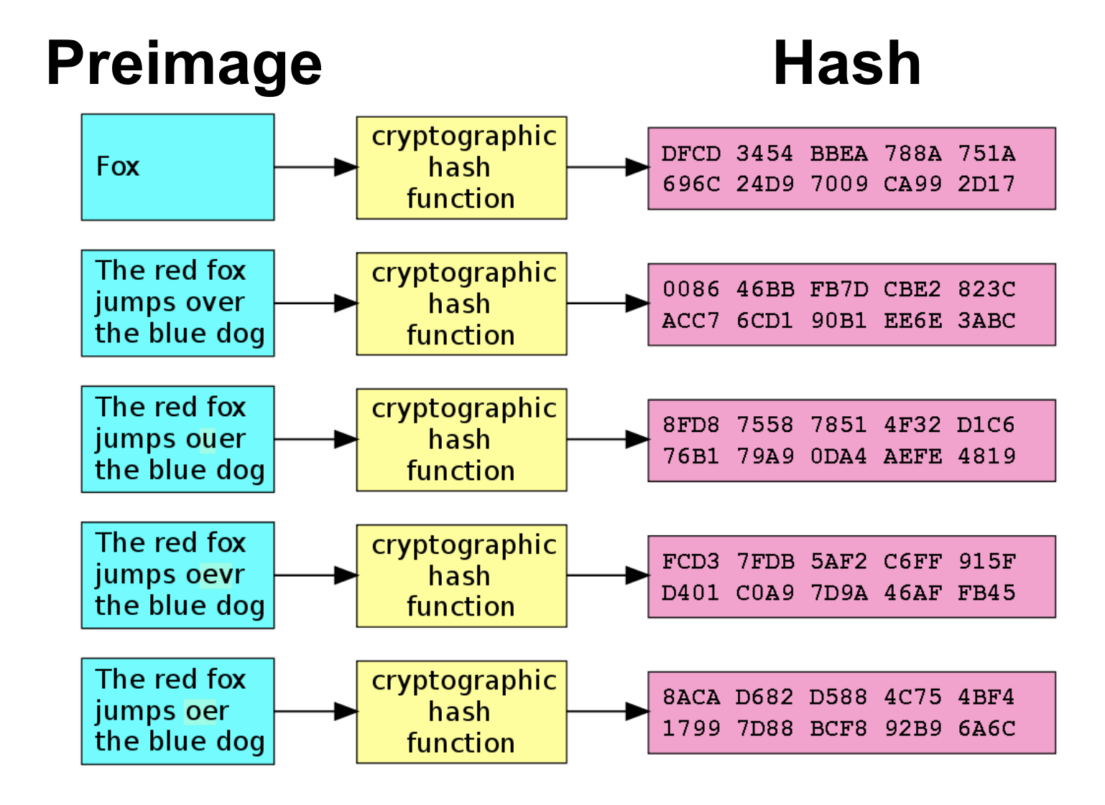
Hashing
Cryptographic hash functions (such as MD5, SHA-256, SHA-3) are designed with strong mathematical properties.
They generate a fixed-length fingerprint from any input data, and even a 1-bit change in the input produces a completely different hash output (this is called the avalanche effect).
Key characteristics :
One-way process: Hashing is irreversible; you cannot decrypt the hash to get the original data.
Fixed-length output: Regardless of the input size, a hash function always produces a hash value of a consistent length.
Unique hash values: Different inputs will produce different hash values, making it highly unlikely for two distinct data sets to have the same hash.

Slide 21
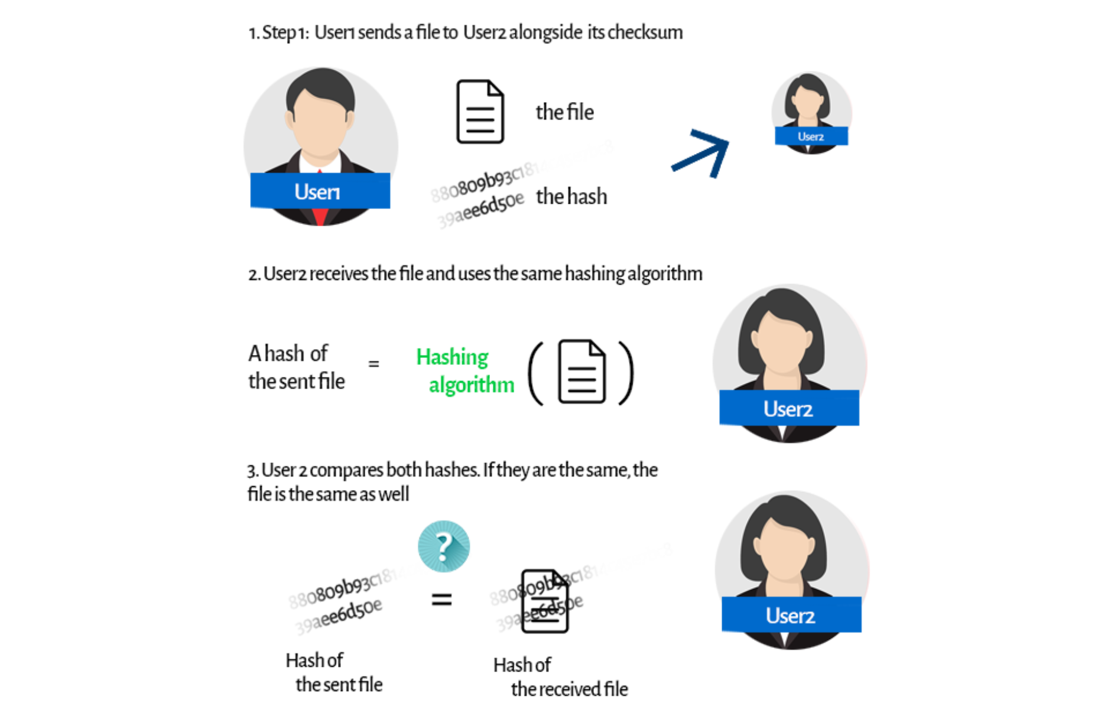
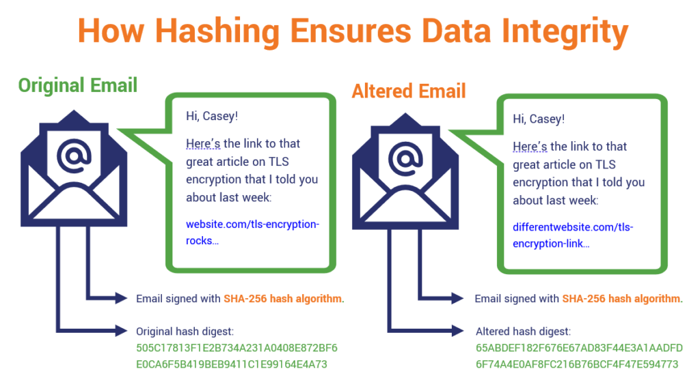
How Hash Functions Work

Slide 22
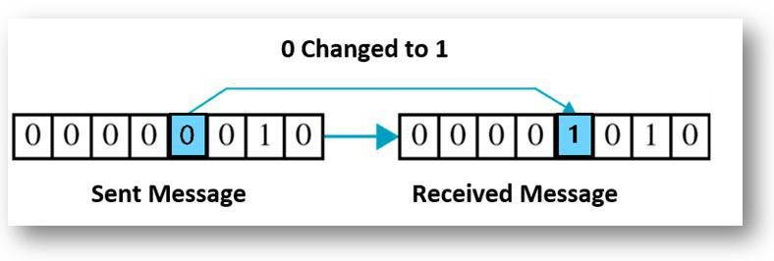
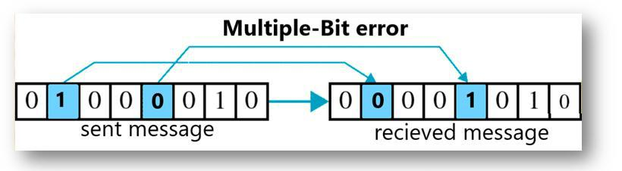
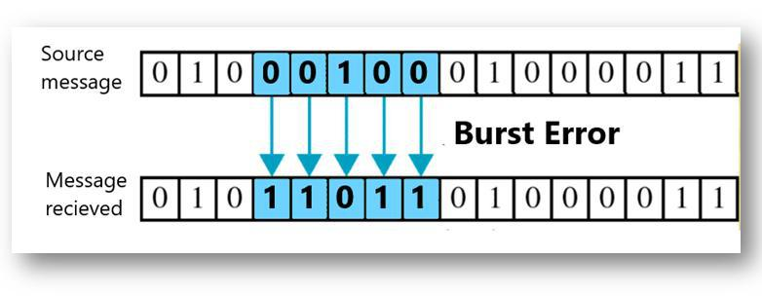
Correction codes
Data is transformed into bits during dissemination. As a result, there can be single-bit errors, errors in two or more bits or change in set of bits known as burst errors during transfers.
Correction codes, such as Error-Correcting Codes (ECC), enhance data integrity by adding redundancy to data, allowing errors from noise or corruption to be detected and corrected during transmission or storage. They work by attaching extra bits, known as check bits or parity bits, to the original data. When the data is received or retrieved, these extra bits help the system verify whether any errors occurred during transmission or storage. If errors are found, the codes can pinpoint the exact location of the corrupted bits and fix them, often without human intervention.
Examples include Hamming Code, which can detect two-bit errors and correct one-bit errors, and Reed–Solomon Code, which is widely used in CDs, DVDs, and QR codes to restore lost data.

Slide 23
Tools for Achieving Availability

Slide 24
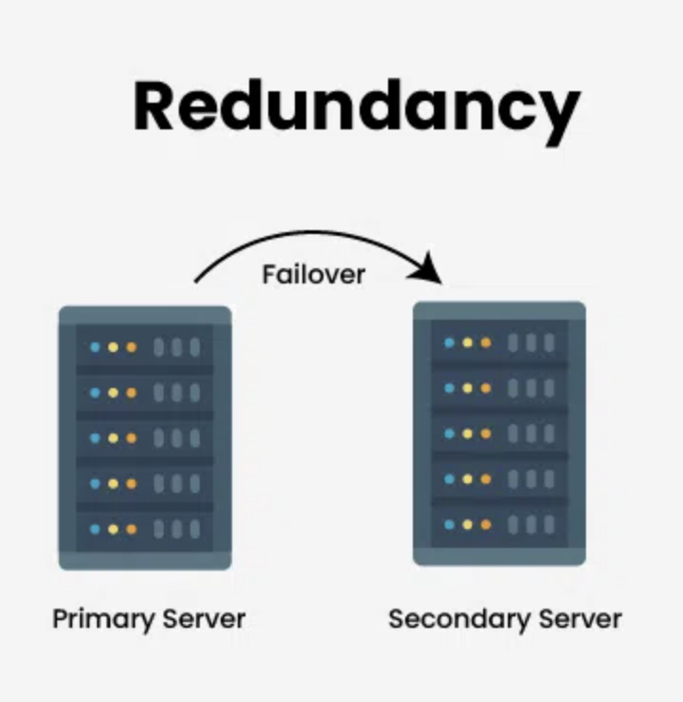
Redundancy & Physical Protection
Redundancy ensures availability by keeping extra copies of systems, components, or data so that if one fails, another can immediately take over.
For example, in a cloud service, the same data is stored on multiple servers across different locations; if one server goes down, users can still access their files from another, ensuring the service remains available without interruption.

Slide 25
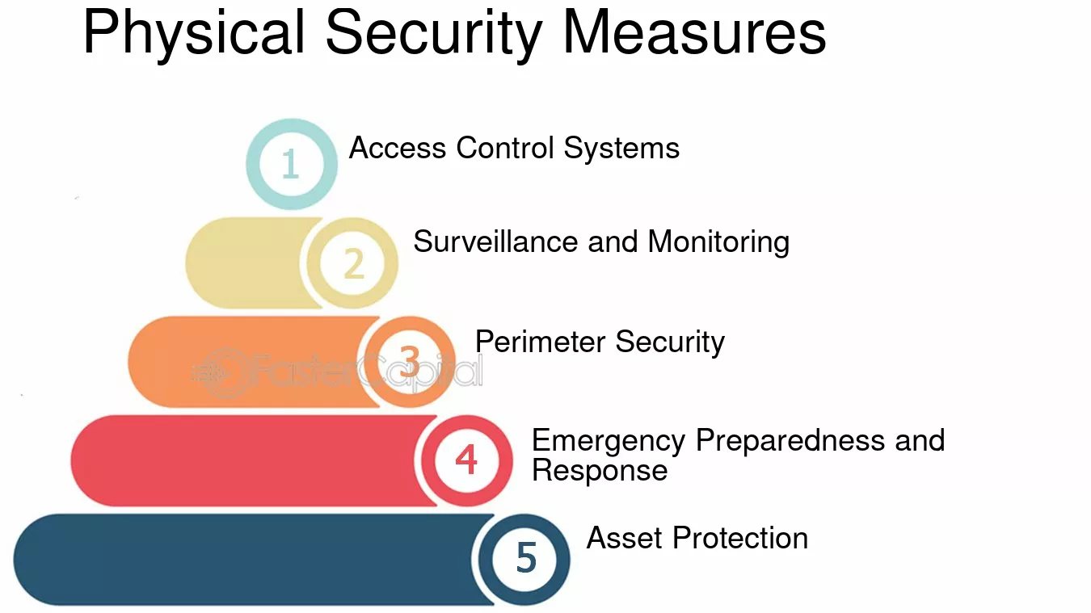
Physical Protection
Physical security provides availability in information security by protecting hardware, facilities, and supporting infrastructure from damage or disruption, ensuring that systems and data remain accessible when needed.
Installing backup power supplies (UPS, generators), fire suppression systems, cooling systems, redundant hardware, and disaster recovery sites are some methods employed for ensuring availability through physical protection.

Slide 26
Thank You

